Slide 1
The Mammalian Protein–Protein Interaction
Database and Its Viewing System That Is Linked to the Main FANTOM2 Viewer
Genome Research (2003)
Speaker: 蔡欣吟
Advisor: 薛佑玲 老師

Slide 2
Introduction
Protein – protein interaction database (PPI database)
The FANTOM2 viewer

Slide 3
FANTOM
The Functional Annotation meeting of mouse cDNA
  The RIKEN Genome Exploration Research (GER) group
  The RIKEN Mouse Gene Encyclopedia Project
  Determining the full coding potential of the mouse genome
  FANTOM in 2000 to annotate first 21,076 cDNAs

Slide 4
FANTOM2
The second Functional Annotation meeting of mouse cDNA (2002)
  The functional annotation of 60,770 full-length cDNAs
  Provide the appropriate gene name, gene symbol, coding sequence information, and relevant gene ontology (GO)
  http://fantom2.gsc.riken.go.jp/

Slide 5
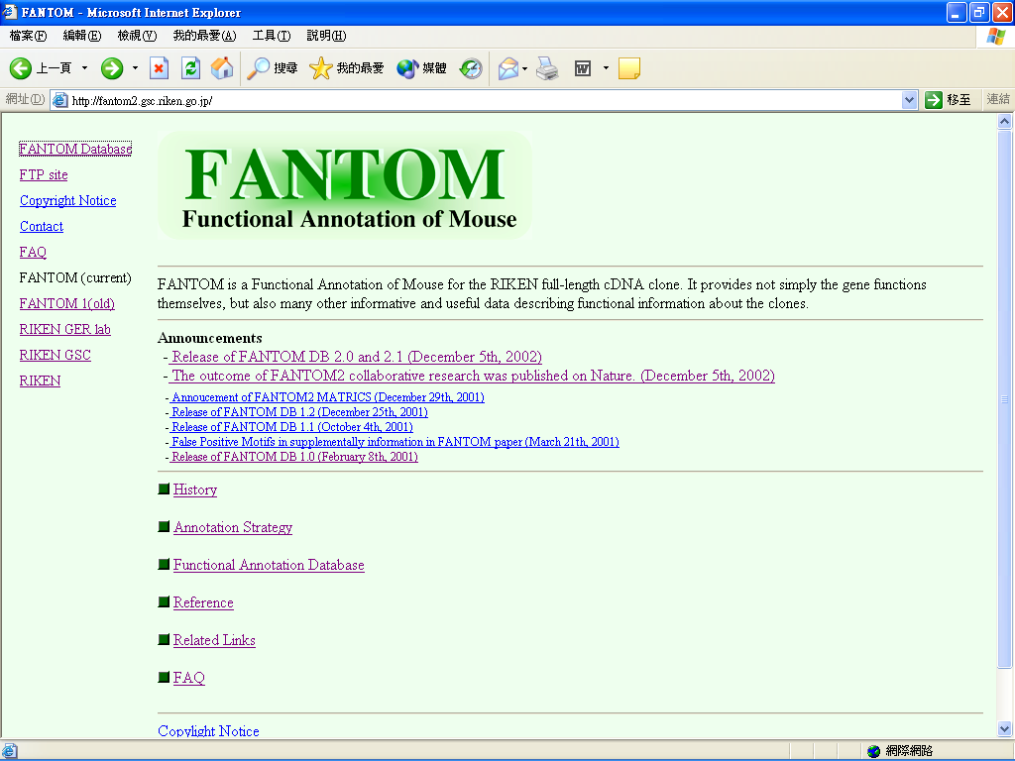

Slide 6
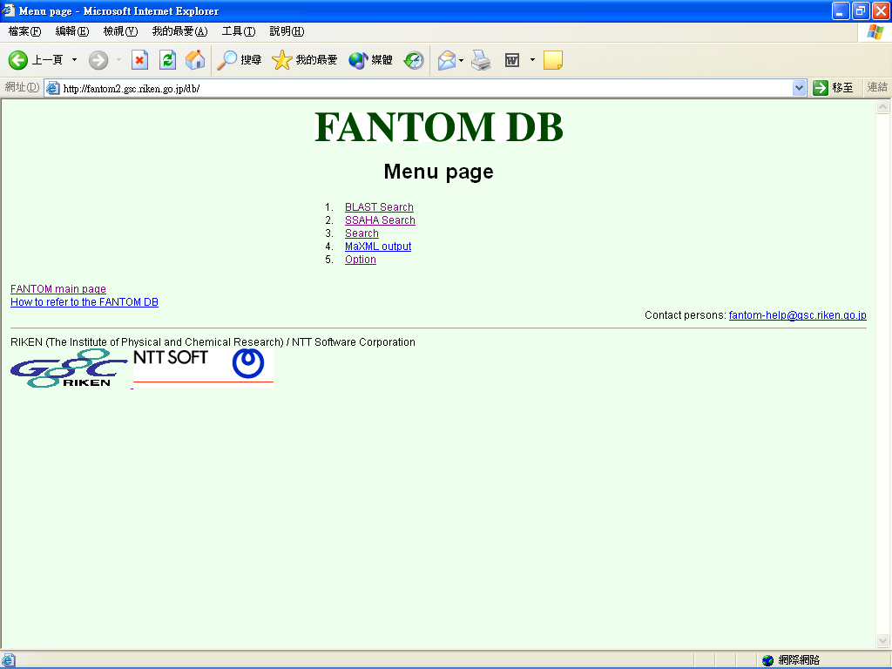

Slide 7
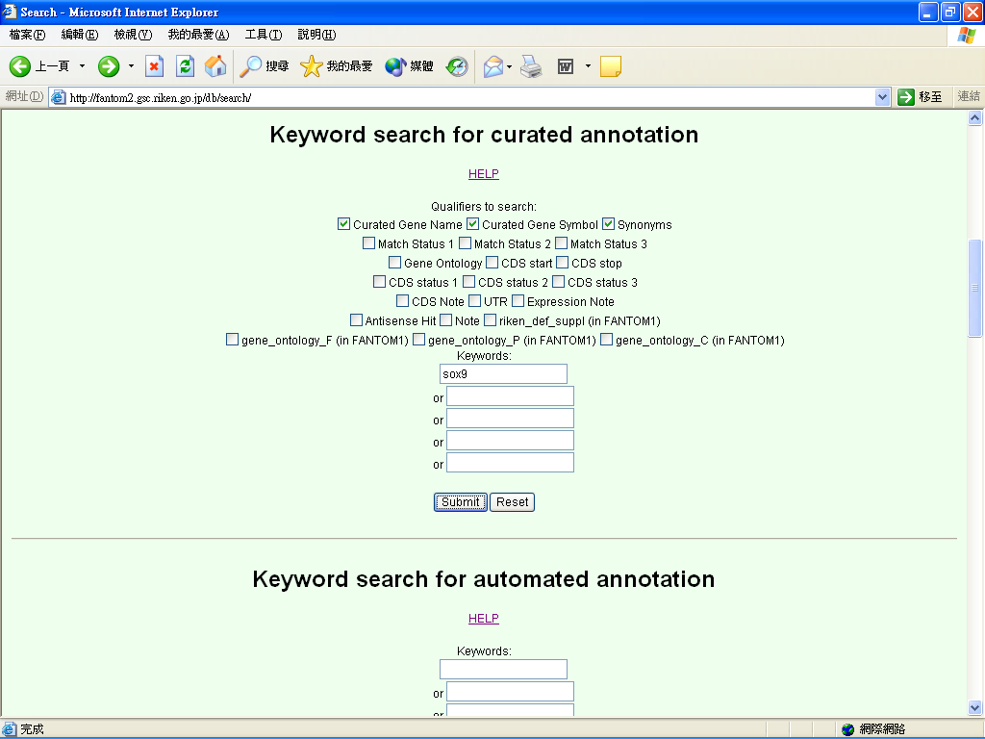

Slide 8
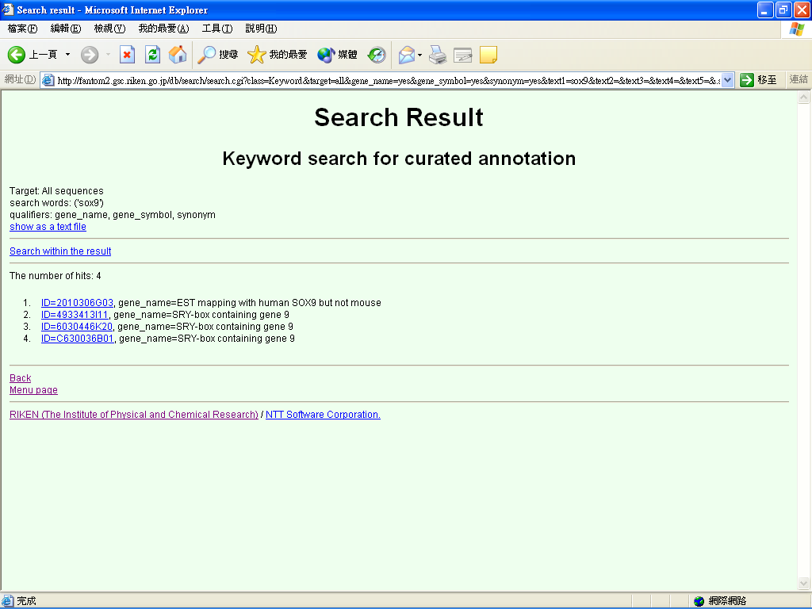

Slide 9
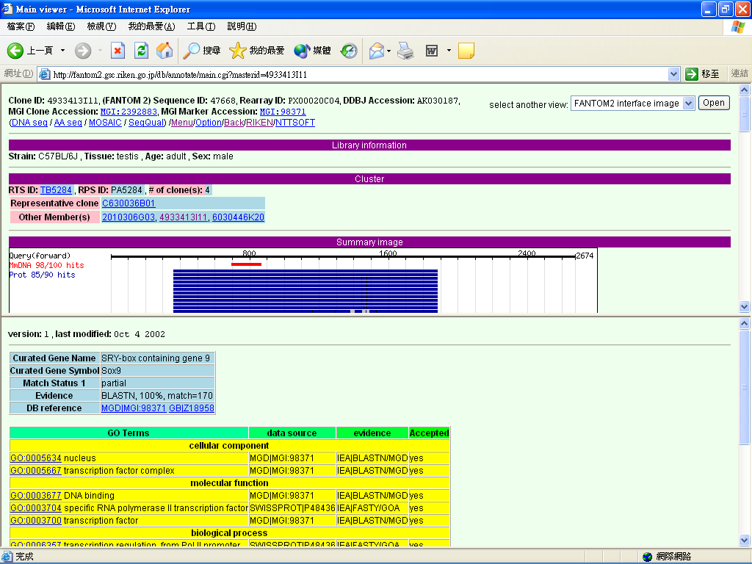
The FANTOM2 viewer

Slide 10
RIKEN PPI Database
Internal
  Experimental PPI data
External
  DIP
  BIND
  FACTS

Slide 11
The DIP database
Database of Interacting Proteins
http://dip.doe-mbi.ucla.edu/

Slide 12
The usage of DIP
Study
Protein function
Protein-protein relationship
Evolution of protein-protein interaction
The network of interacting proteins
The environments of protein-protein interactions
Predict
Unknown protein-protein interaction
The best interaction conditions

Slide 13
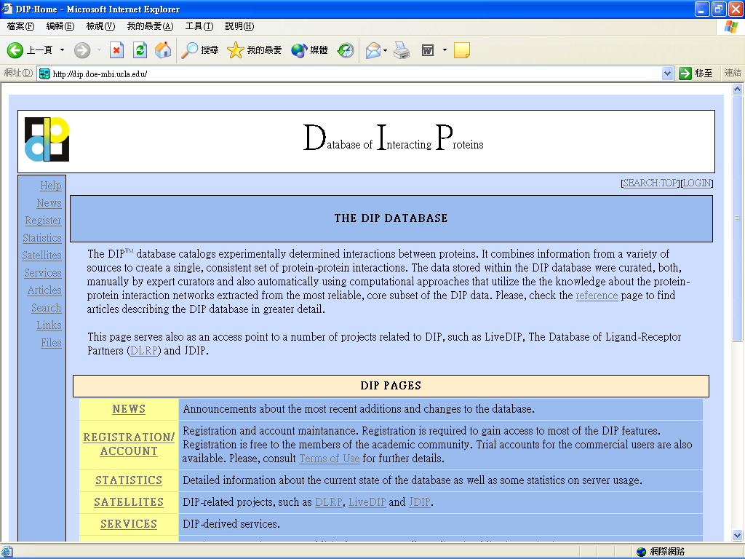

Slide 14
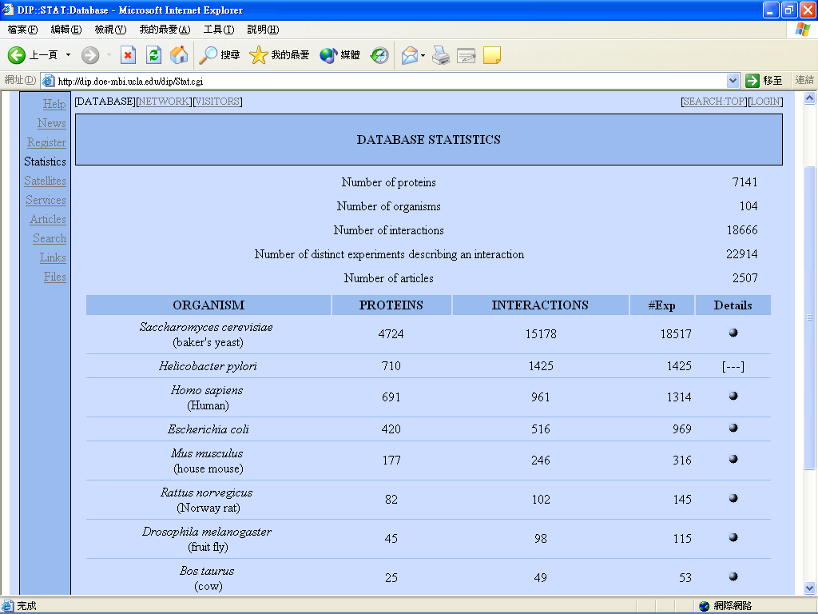
Current DIP Database Statistics

Slide 15
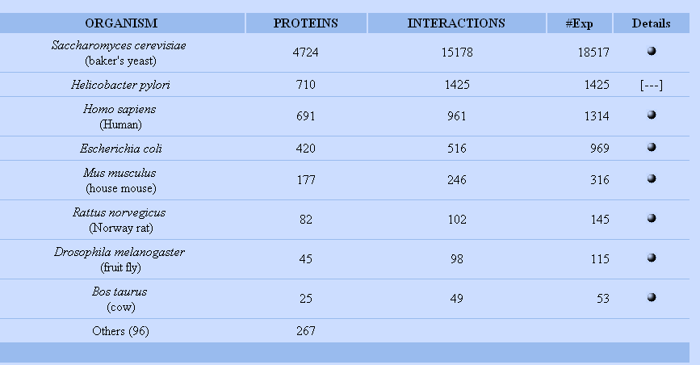

Slide 16
The BIND database
The Biomolecular Interaction Network Database
http://www.binddb.org/

Slide 17
What kind of data stored in BIND
INTERACTION: The interaction between two molecules as well as any chemical reactions that occur as a direct result of interaction.
  Example: P-P, P-n, P-s. (phosphorylation of P, methylation of D, hydrolysis of sugar)
COMPLEX: describes a molecular complex by listing the series of interaction records that are present in the complex.
  Example: multi-sub enzyme, actin fiber, ribosome
PATHWAY: describes a cellular process pass a sequential list of interaction records and its associated Chemical Action data.
  Example: cell-signaling pathway, synthesis of an amino acid, transcription and splicing of a pre-massager RNA.

Slide 18
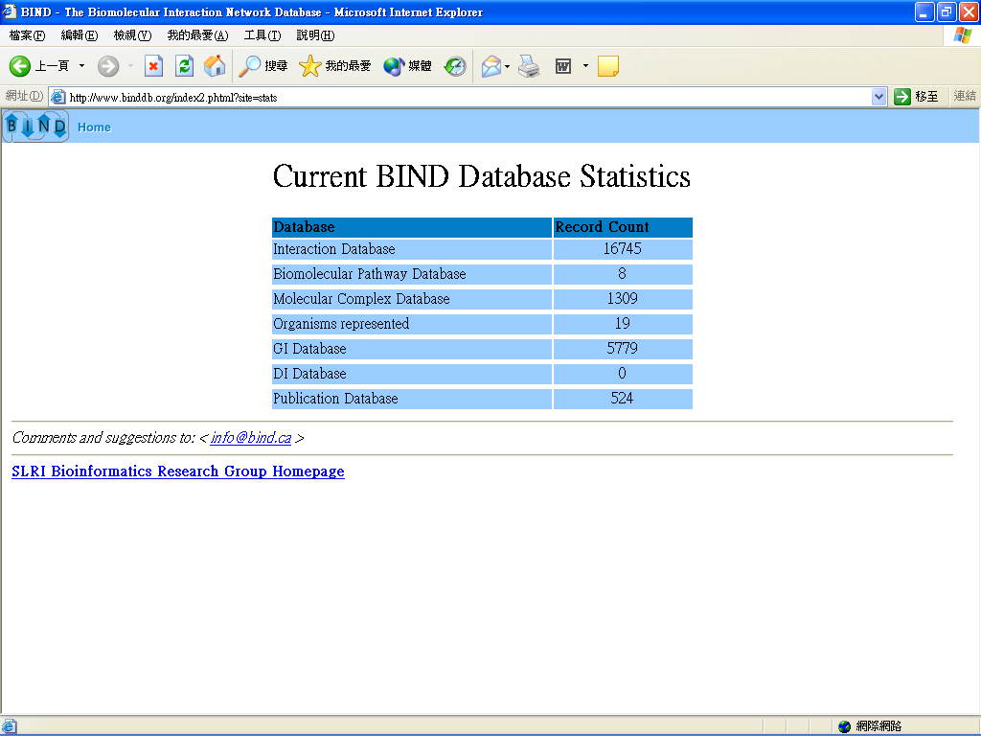
Current BIND Database Statistics

Slide 19
The FACTS database
Functional Association/Annotation of cDNA Clones from Text/Sequence Sources
http://facts.gsc.riken.go.jp

Slide 20
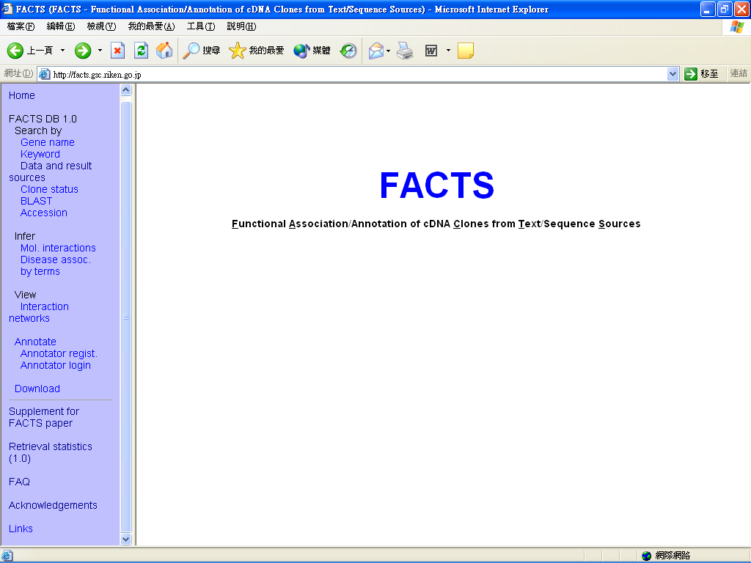

Slide 21
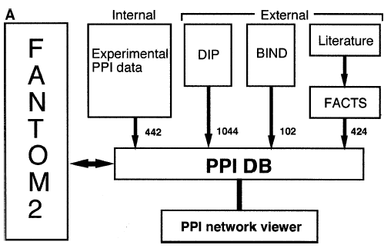
RIKEN PPI Database

Slide 22


The Two-Hybrid System
Two hybrid proteins are generated with transcription factor domains
Both fusions are expressed in a yeast cell that carries a reporter gene whose expression is under the control of binding sites for the DNA-binding domain
Activation
Domain
Prey
Protein
Bait
Protein
Binding
Domain
Reporter Gene

Slide 23
The Two-Hybrid System
Interaction of bait and prey proteins localizes the activation domain to the reporter gene, thus activating transcription.
Since the reporter gene typically codes for a survival factor, yeast colonies will grow only when an interaction occurs.
Activation
Domain
Prey
Protein
(BIND protein)
Reporter mRNA
Bait
Protein
(ACT protein)
Reporter mRNA
Reporter mRNA
Binding
Domain
Reporter mRNA
Reporter mRNA
Reporter Gene

Slide 24
The Protein-Protein Interaction Database
The major part of PPIs in many PPI database is yeast PPI
  The high number of false-positive interaction
  Data from two independent research groups showed very little overlop
The development of mammalian PPI database
  RIKEN PPI database
  http://fantom21.gsc.riken.go.jp/PPI/

Slide 25
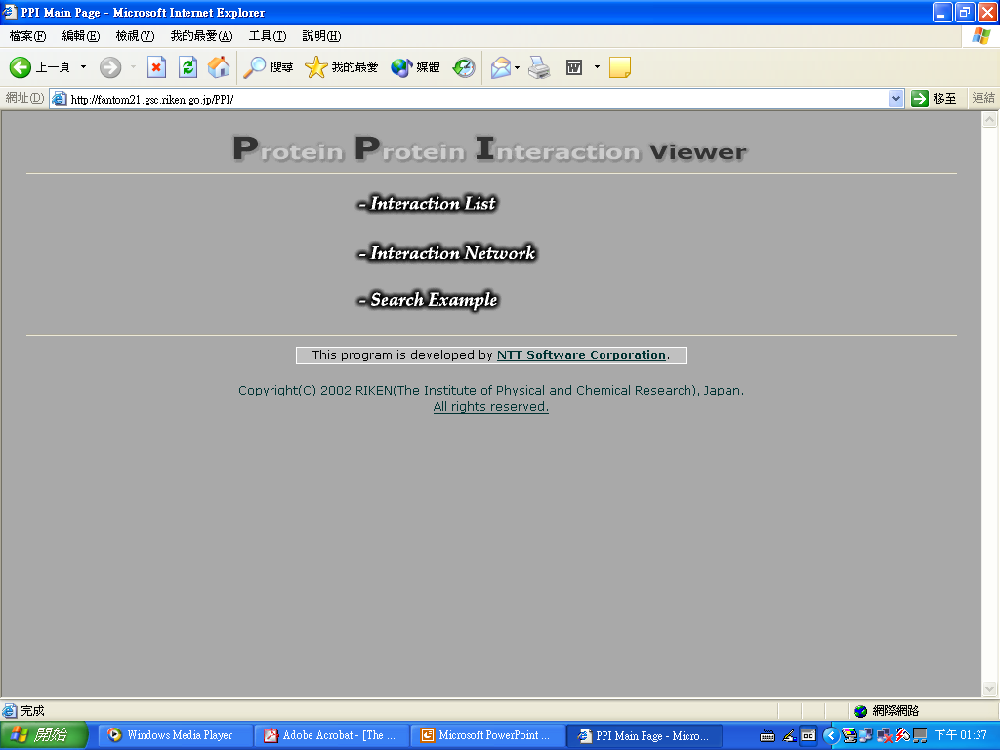

Slide 26
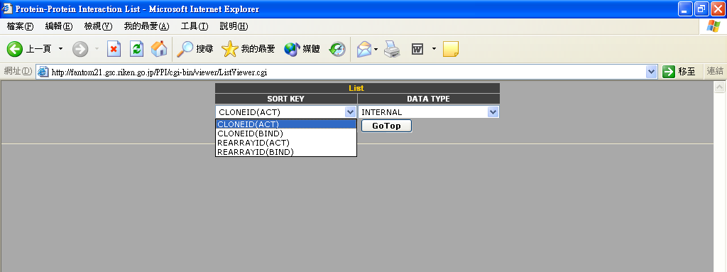
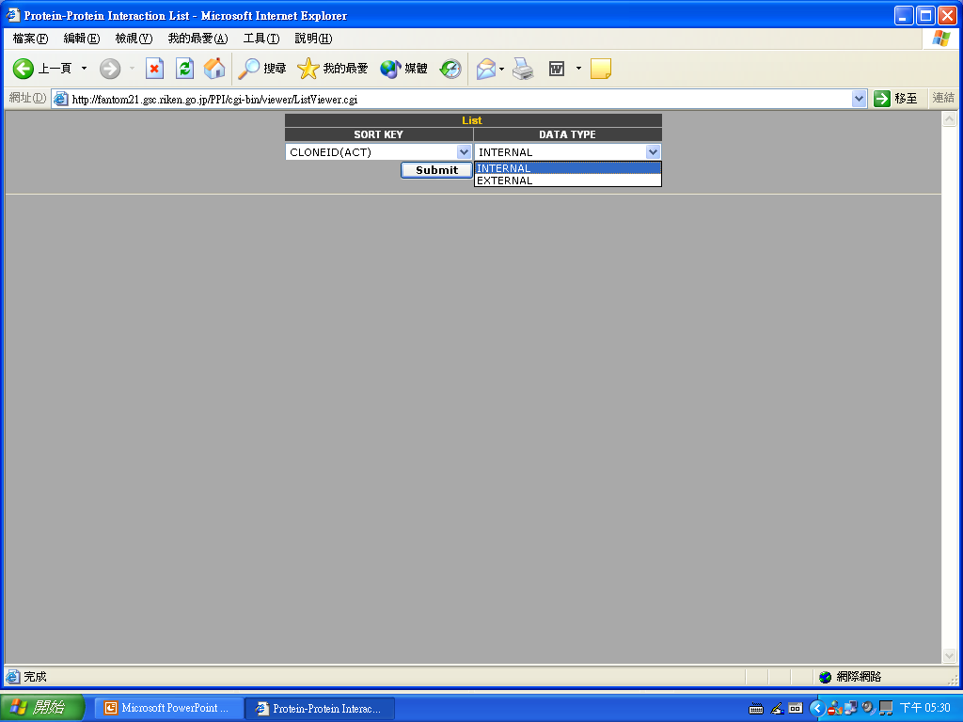

Slide 27
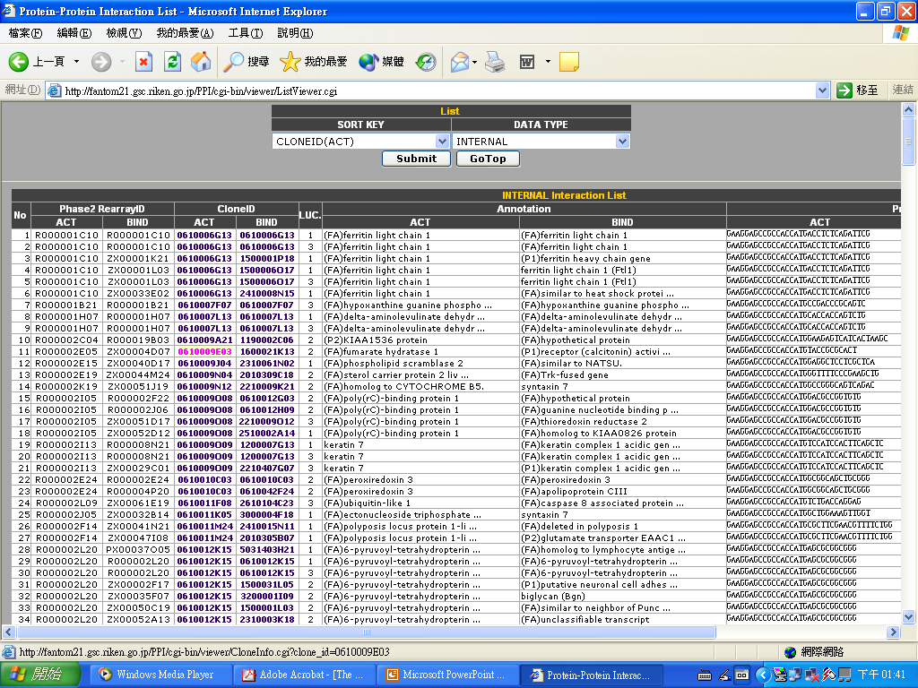

Slide 28
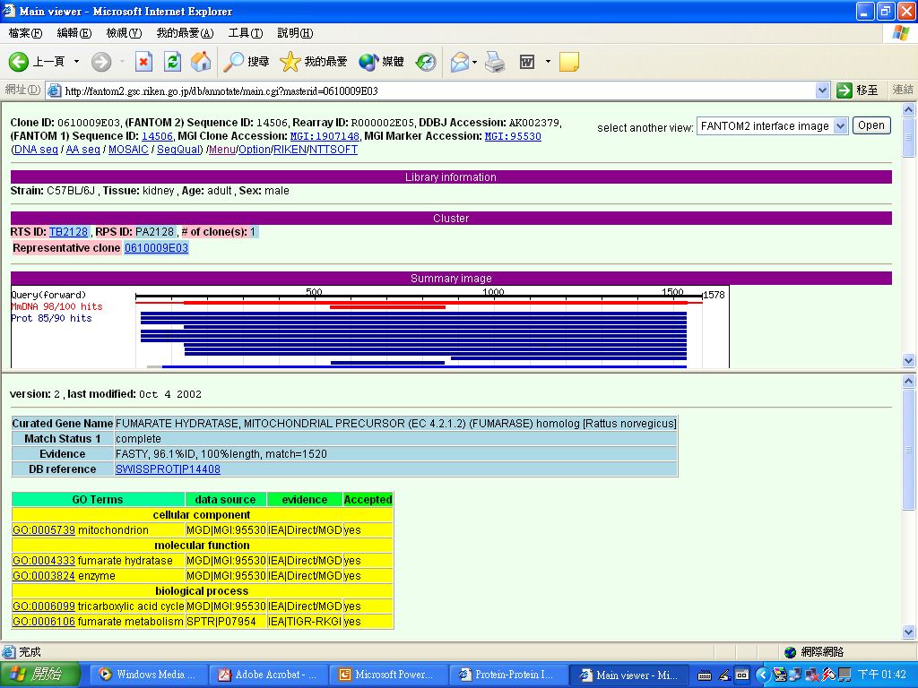

Slide 29
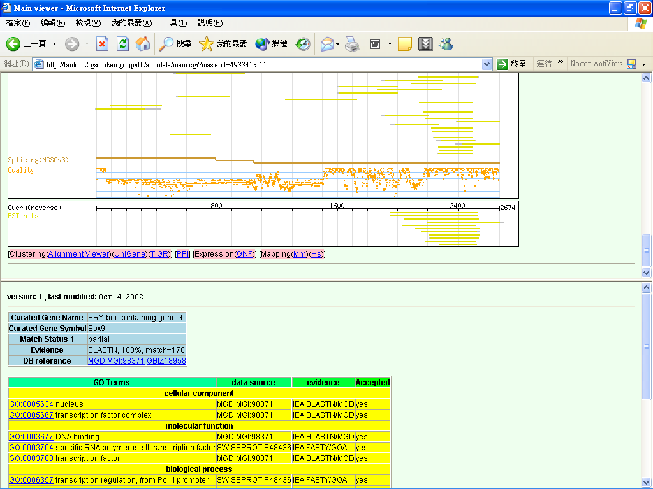

Slide 30
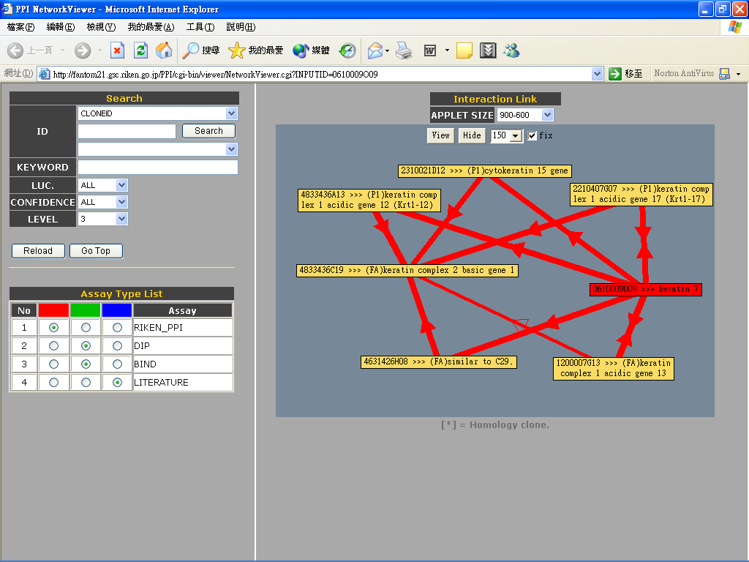

Slide 32
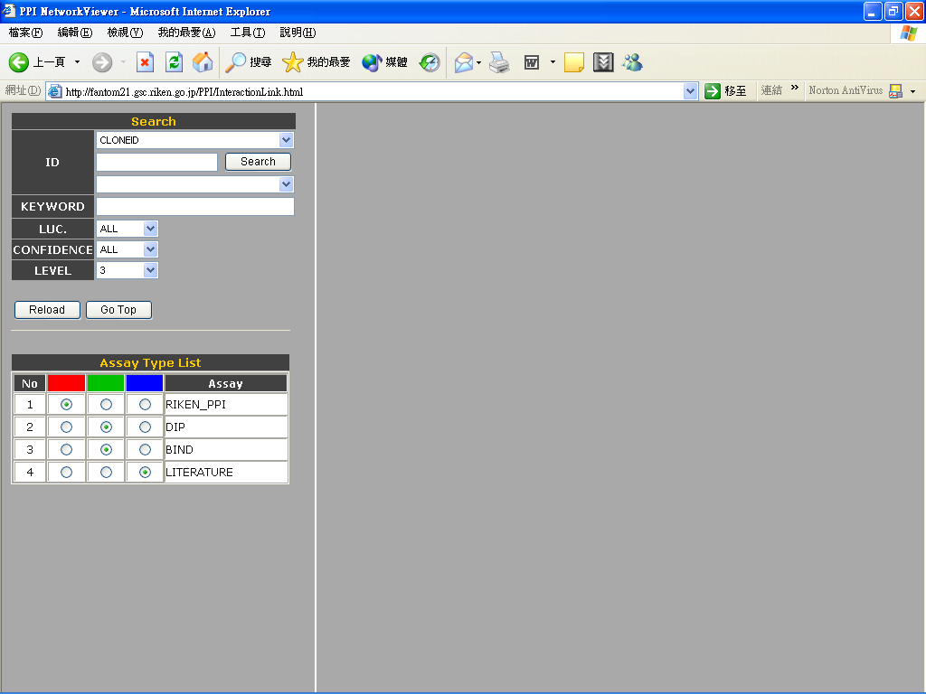

Slide 33
Get Clone ID
FANTOM database
Keyword search
Get clone ID

Slide 34
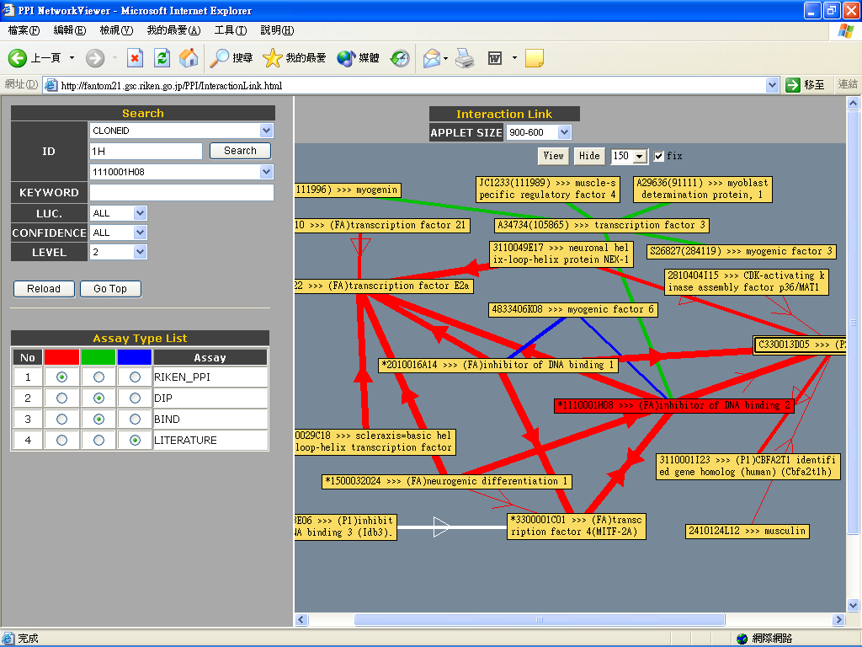

Slide 36
FANTOM database
Keyword search
Clone ID
FANTOM viewer
PPI

Slide 38
The RIKEN PPI Database
Advantage
  The mammalian PPI database
Improvement
  Need more data

Slide 39
Thank You for Your Attention

